Slide 1
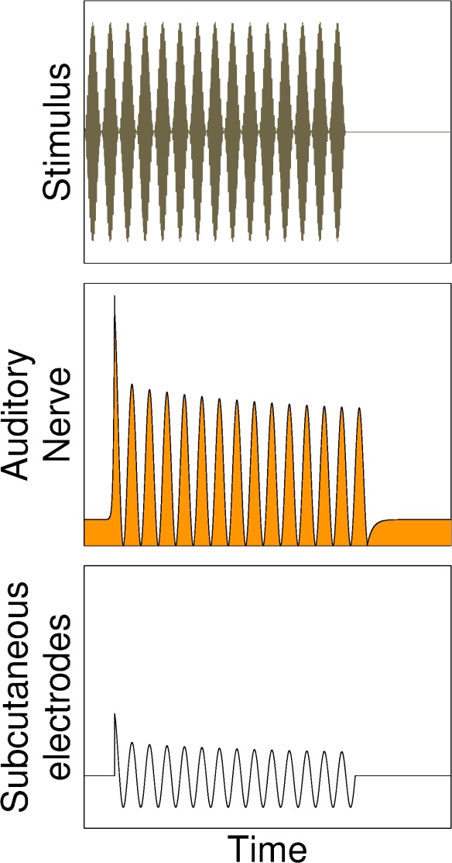
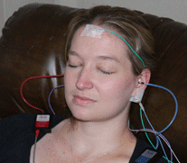
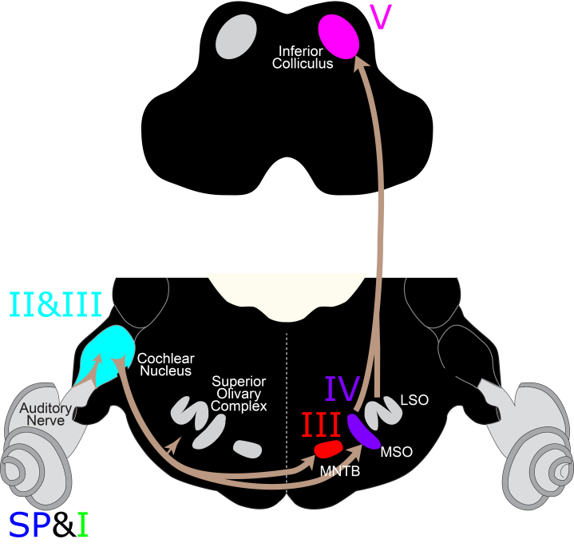
Envelope Following Response (EFR)
An auditory evoked response
Stimulus: sinusoidally amplitude-modulated (SAM) tone
Tone Pip (ABR)
Tone
100 milliseconds
Notes:
Kujawa and Liberman exposed 16 week-old mice to 100dB octave-band noise, and observed an ~50% loss of ANFs, but no threshold shift.
Auditory Brainstem Response – Play a short tone to the mouse, record gross electrical potential using electrodes on vertex and pinna.
Wave I is known to be generated by the firing of ANFs….
In the damaged region wave I amplitudes do not recover. This makes sense with high-threshold ANF loss.
Question: how prevalent is ANF loss in humans, can it explain complaints of hearing in noise despite normal thresholds?
ABR in humans?
Mice are littermates: genetically identical, same age, weight, gender. Humans are very much the opposite. Genetic differences cause variations in head shape and size, leading to variability in ABR amplitudes.

Slide 2
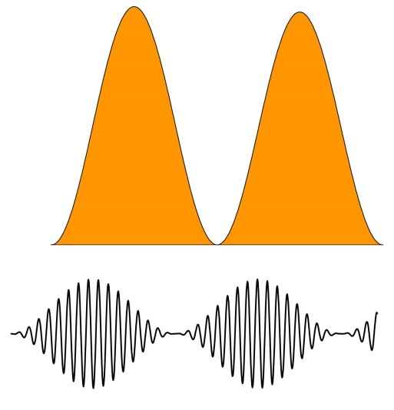
Envelope Following Response (EFR)
An auditory evoked response
Stimulus: sinusoidally amplitude-modulated (SAM) tone
Tone Pip (ABR)
Tone
Modulation
Frequency
SAM-tone
Stimulus
Carrier
Frequency
Auditory
Nerve
Response
Average
Rate
Modulated
Rate
100 milliseconds
Notes:
Kujawa and Liberman exposed 16 week-old mice to 100dB octave-band noise, and observed an ~50% loss of ANFs, but no threshold shift.
Auditory Brainstem Response – Play a short tone to the mouse, record gross electrical potential using electrodes on vertex and pinna.
Wave I is known to be generated by the firing of ANFs….
In the damaged region wave I amplitudes do not recover. This makes sense with high-threshold ANF loss.
Question: how prevalent is ANF loss in humans, can it explain complaints of hearing in noise despite normal thresholds?
ABR in humans?
Mice are littermates: genetically identical, same age, weight, gender. Humans are very much the opposite. Genetic differences cause variations in head shape and size, leading to variability in ABR amplitudes.

Slide 3
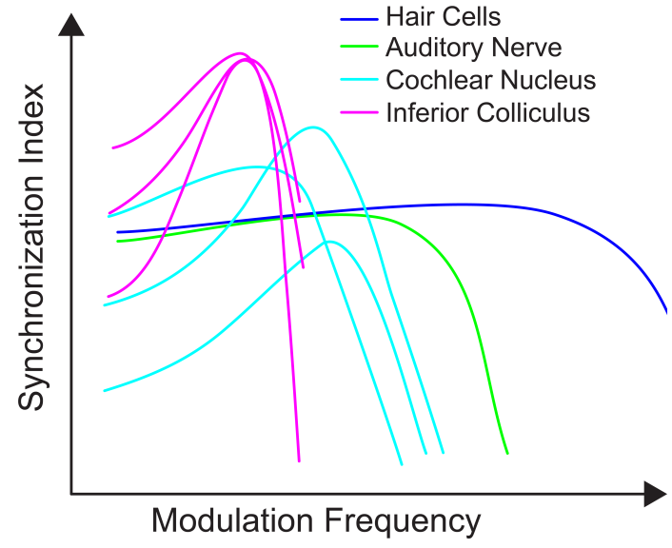
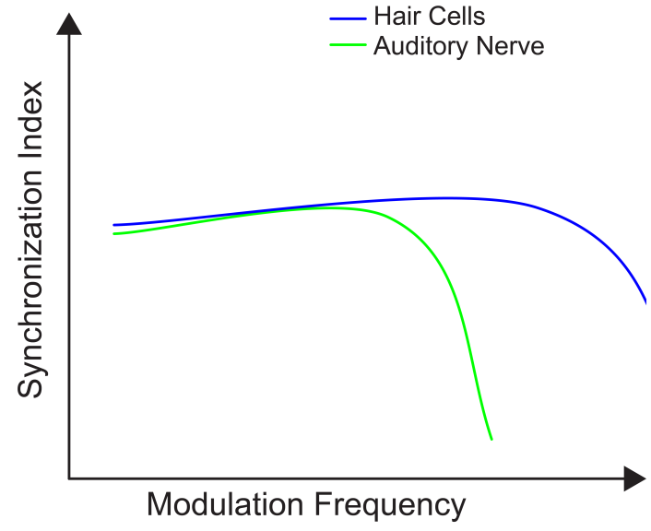
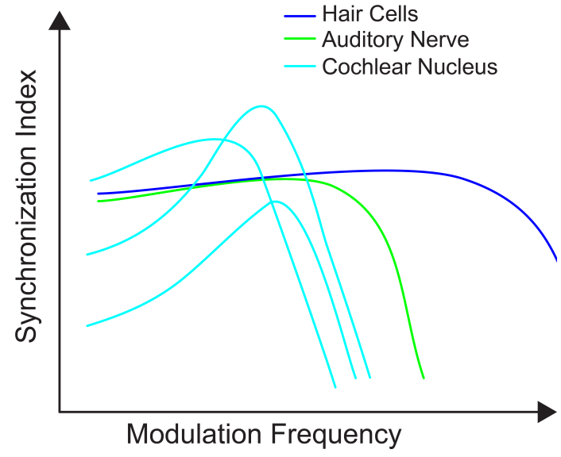
Envelope Following Response (EFR)
As you ascend the auditory system, the maximum frequency a neuron can follow decreases
EFR
Joris et al 2004

Slide 4
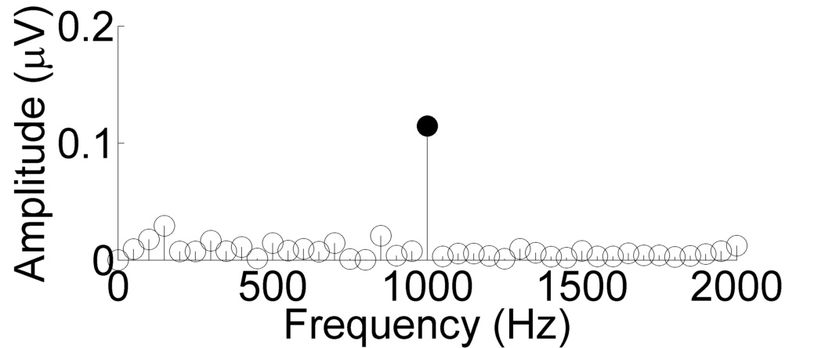
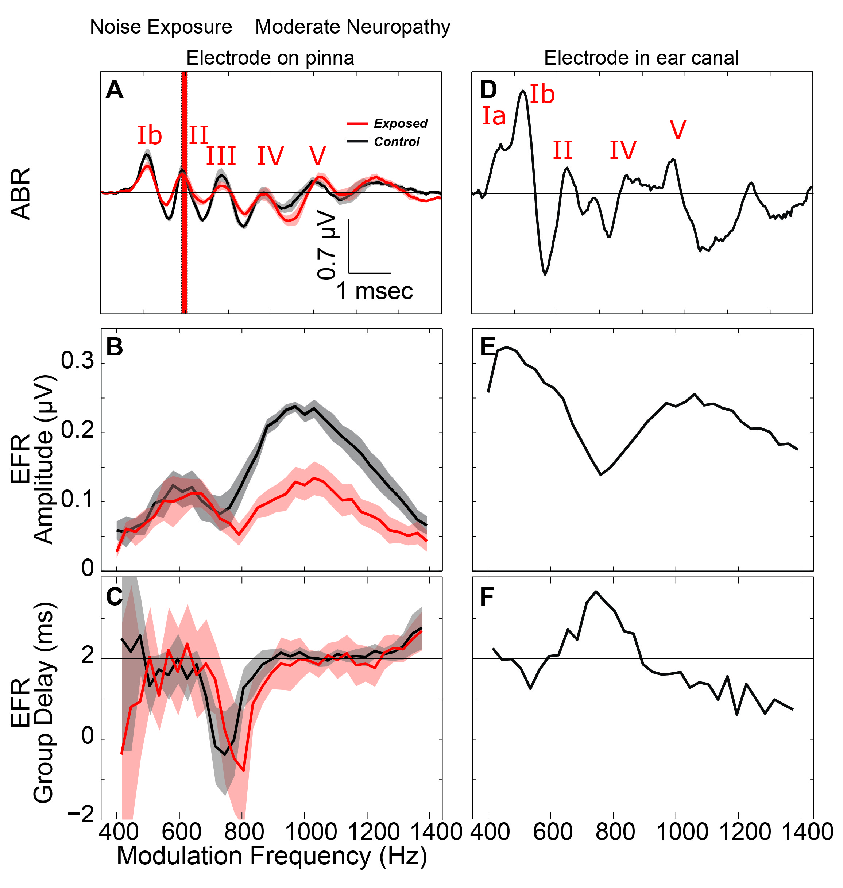
Steps to Analyze EFR:
1. For each stimulus:
1a. Compute Fourier transform
1b. Extract amplitude at modulation frequency
Repeat step 1 for all stimuli
Plot amplitude vs. modulation frequency
Response to 1 kHz
modulation frequency
100 milliseconds
Notes:
Continuous stimulus

